Slide 1

STATISTICAL INFERENCE PROJECT
Diabetes Dataset

Slide 2


Dataset Preprocessing
we have 9 columns which are Pregnancies, Glu,cose, BloodPressure, SkinThickness, Insulin, BMI,Diabetes, PedigreeFunction, Age, Outcome
We replaced the null values (zeros) by mean from:
Glucose
BloodPressure
SkinThickness
insulin
BMI

Slide 3
PART 1: EXPLORATORY ANALYSIS

Slide 4
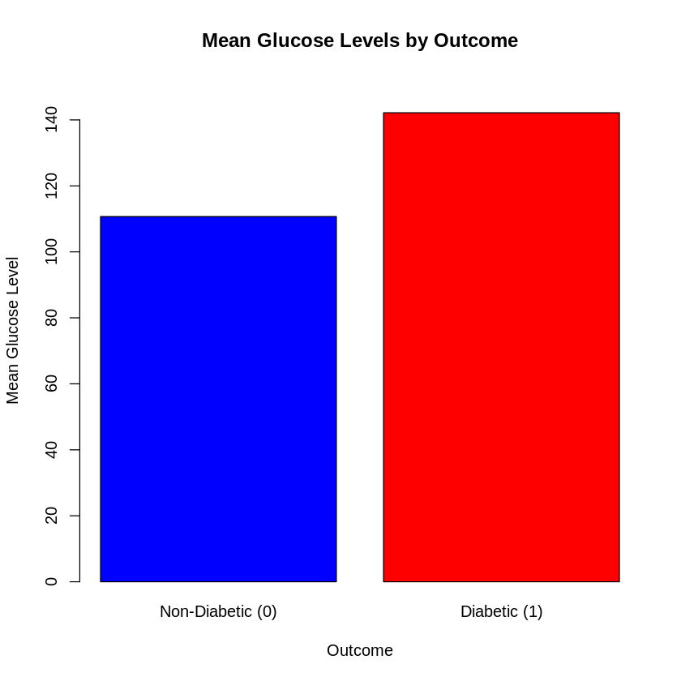
1- The average glucose levels among patients with and without diabetes
The bar chart demonstrates that patients with diabetes have significantly higher average glucose levels compared to those without diabetes. The average glucose level for patients without diabetes is approximately 110 mg/dL, while for patients with diabetes, it is significantly higher at approximately 142 mg/dL.

Slide 5
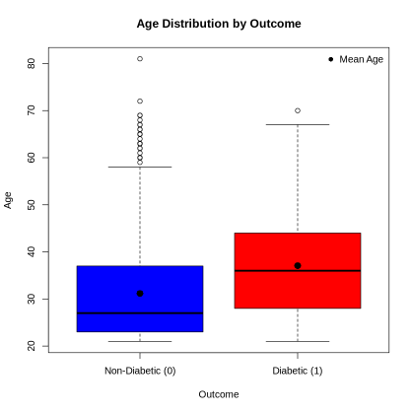
2- The average age of patients with and without diabetes.
Non-Diabetic : The blue bar indicates the mean age of patients without diabetes. It appears to be around 31 years.
Diabetic : The red bar represents the mean age of patients with diabetes. It shows that it is approximately 37 years.
Conclusion: the average age of patients with diabetes is higher that those who are without diabetes.

Slide 6
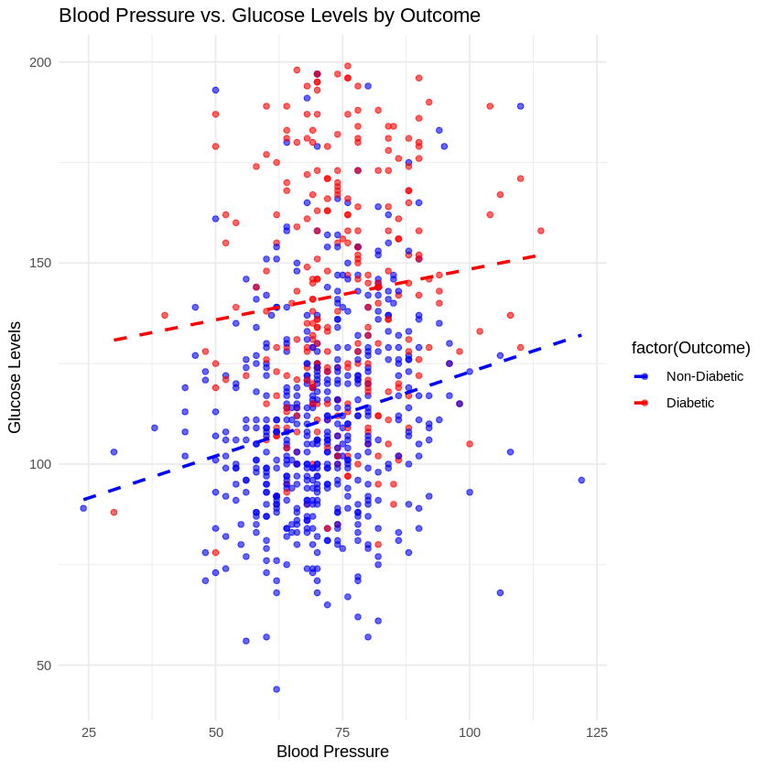
3- The average blood pressure measurements across diabetic and non-diabetic groups.
Non-Diabetic : The blue bar indicates the mean blood pressure of patients without diabetes. It appears to be around 70.8 mmHg.
Diabetic: The red bar represents the mean blood pressure of patients with diabetes. It seems to be approximately 74 mmHg.
Conclusion:
The visualization indicate that the average blood pressure is significantly higher for patients with diabetes compared to those without diabetes.

Slide 7
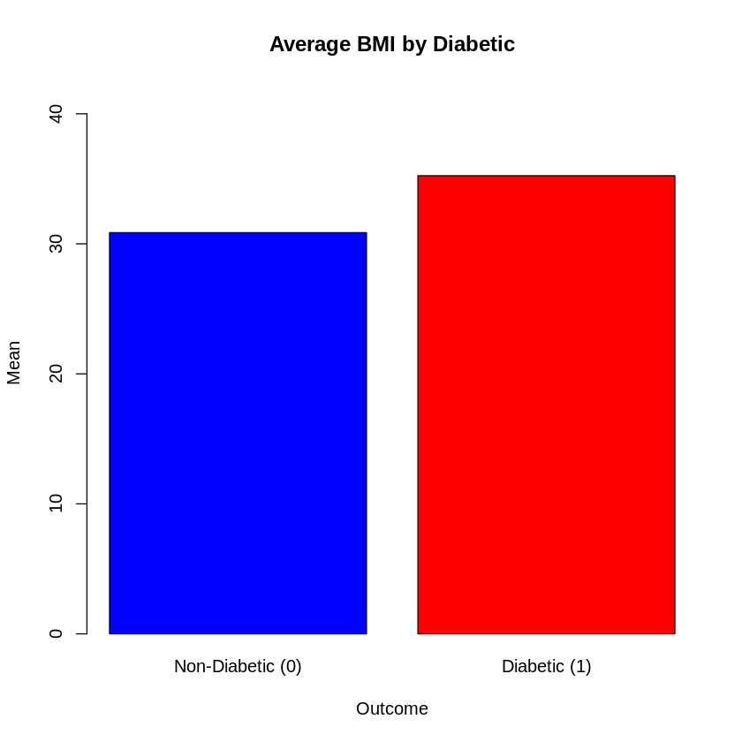
4- The average BMI of diabetic versus non-diabetic patients.
Non-Diabetic: The blue bar indicates the mean BMI of patients without diabetes. It appears to be around 30 kg/m2.
Diabetic : The red bar represents the mean BMI of patients with diabetes. It seems to be approximately 38 kg/m2.
Conclusion:
The visualization shows that the average BMI is significantly higher for patients with diabetes compared to those without diabetes.

Slide 8
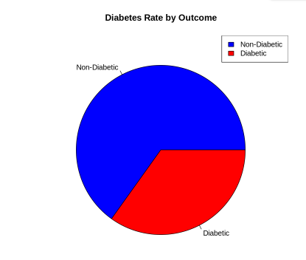
5- The rate of diabetes among patients in the dataset.
Non-Diabetic: It is around 65%.
Diabetic: it around is 35%.
Conclusion:
The visualization shows that approximately 35% of the patients in the dataset have diabetes, while the remaining 65% are non-diabetic.

Slide 9
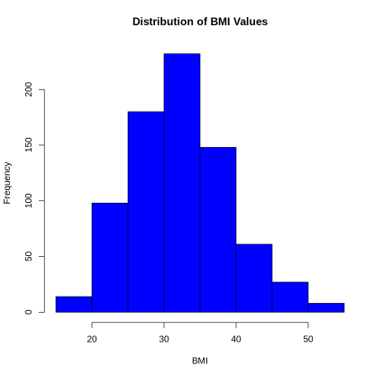
6- The distribution of BMI values among all patients.
The distribution of BMI values among the patients is right-skewed, with a mean BMI of 32.45 and a median of 32. This indicates that a larger proportion of patients have lower BMI values, while a smaller proportion have higher values. The standard deviation of 6.88 suggests a moderate level of variability in BMI within the sample.

Slide 10
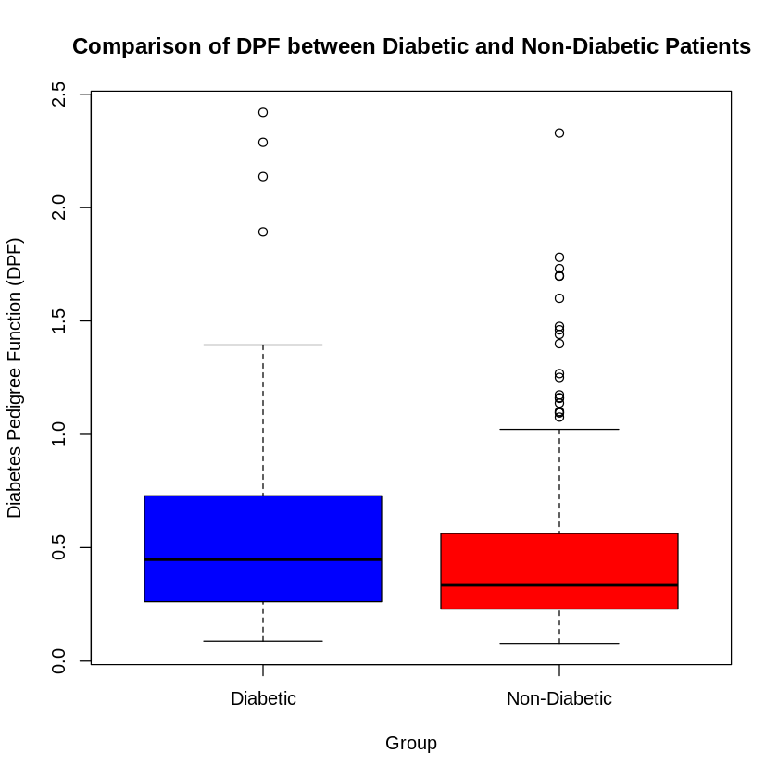
7- The distribution of Diabetes Pedigree Function (DPF) values for diabetic and non-diabetic patients.
Diabetic patients exhibit a higher median DPF compared to non-diabetic patients, indicating a stronger family history of diabetes in this group.

Slide 11
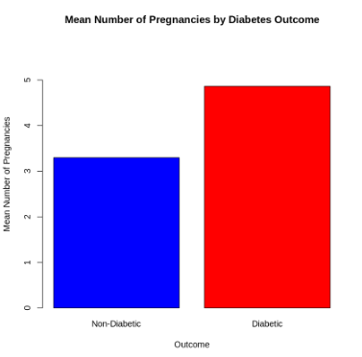
8- The relationship between the number of pregnancies and diabetes occurrence.
The bar plot reveals a clear association between the number of pregnancies and the risk of developing diabetes.
On average, individuals with diabetes have a higher mean number of pregnancies compared to those without diabetes.

Slide 12
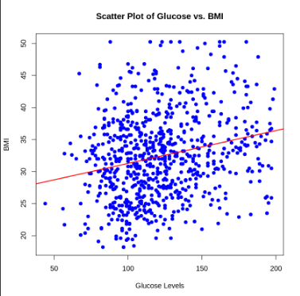
9- The correlation between glucose levels and BMI.
The correlation coefficient of 0.23 indicate a weak positive correlation between Glucose Levels and BMI. So the relation is not very strong

Slide 13
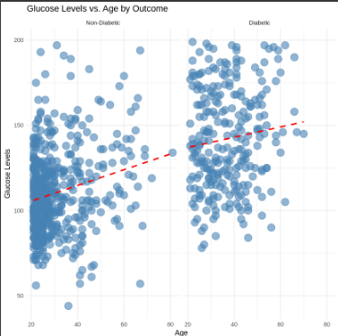
10- The trend of glucose levels with age among diabetic and non-diabetic patients.
The scatter plot reveals that glucose levels tend to increase with age in both diabetic and non diabetic individuals. However, the rate of increase shows that it is higher in diabetic patients.

Slide 14
PART 2: ANSWERING QUESTIONS

Slide 15

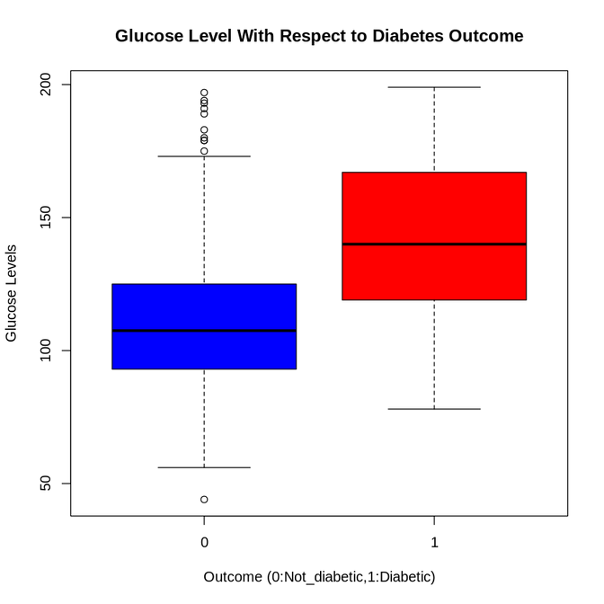
1 .Are higher glucose levels associated with a greater likelihood of diabetes?
T-Test Result
T-statistic: -14.862
p-value: < 2.2e-16 (strong evidence against the null hypothesis)
95% Confidence Interval: [-35.61, -27.30]
Means:
Non-Diabetic (0): 110.7
Diabetic (1): 142.2
Conclusion
Glucose levels are significantly higher in diabetic individuals, as indicated by the t-test.

Slide 16
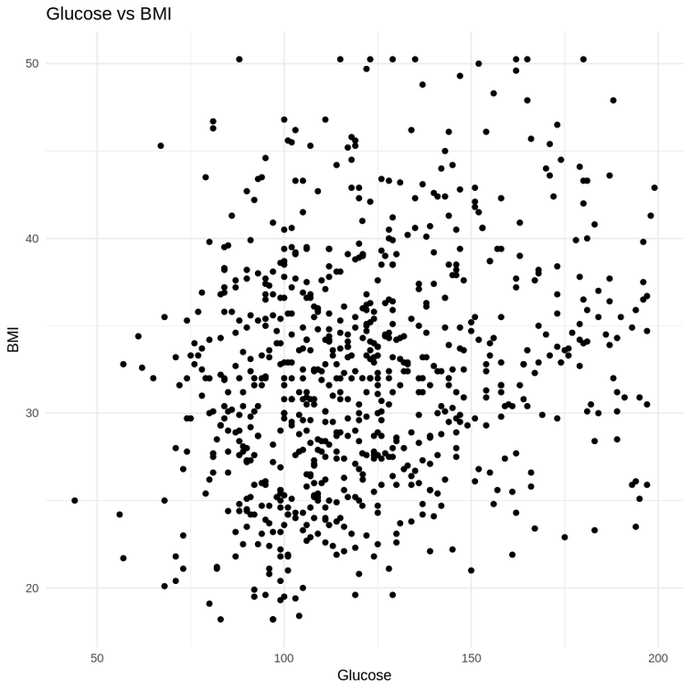
2. Are patients with high glucose concentrations also likely to have higher BMI values?
A failed trial to find a trend in the data
Conclusion:
There is no relation between glucose concentration and BMI

Slide 17
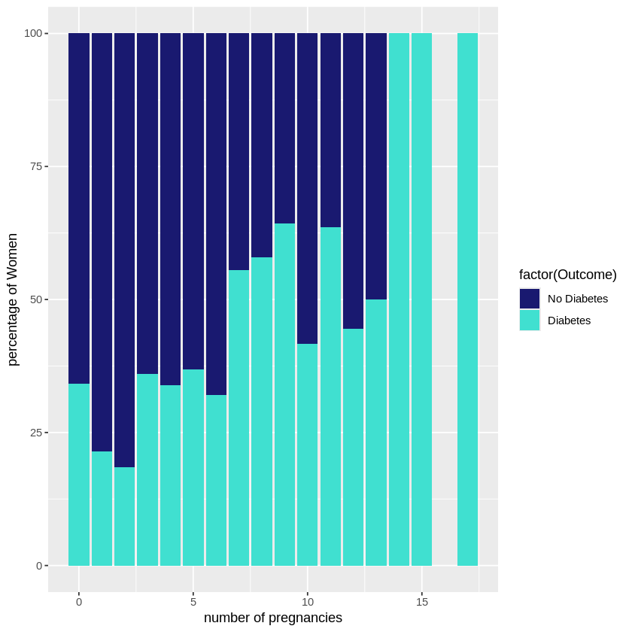
3. Are patients with a higher number of pregnancies at greater risk of developing diabetes?
As the number of pregnancies increases, the proportion of women with diabetes increases, while the proportion of woman with no diabetes decreases so women with a higher number of pregnancies have a greater risk of developing diabetes

Slide 18
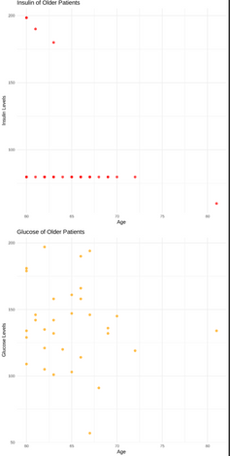
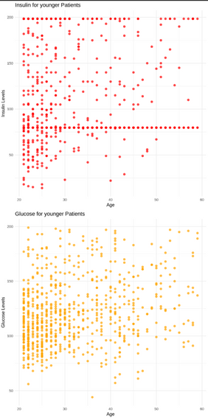
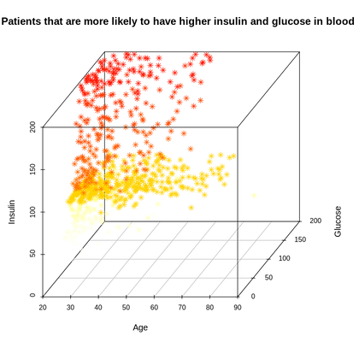
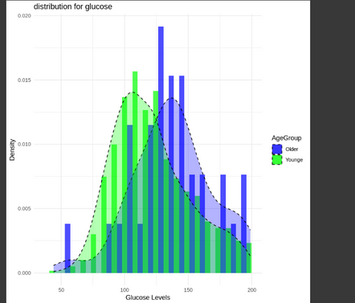
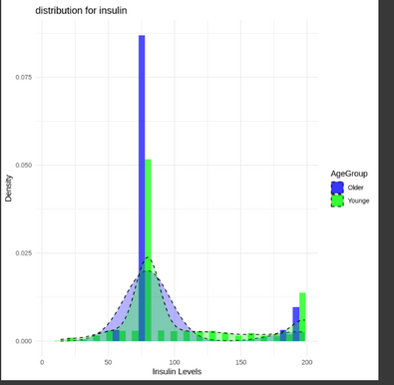
4.Are older patients more likely to have higher insulin concentrations and blood glucose levels?
yes Older patients tend to have slightly higher glucose levels than younger ones, but they have lower insulin levels.

Slide 19
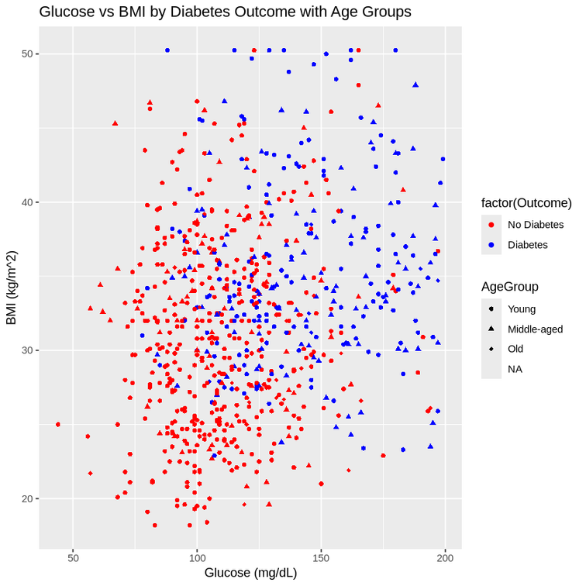
5.Can you identify common “risk profiles” for diabetic patients based on key metrics (glucose, BMI, age, etc.)?
Diabetic patients are commonly associated with higher glucose levels (>120 mg/dL), elevated BMI (≥30 kg/m²), and are more prevalent in middle-aged and older age groups. These factors collectively indicate key risk profiles for diabetes.

Slide 20
SECTION 2.2
5 more bivariate/multivariate analysis questions

Slide 21
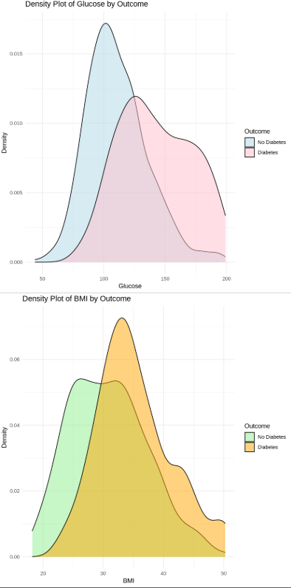
1- Do high glucose levels with high BMI indicate a higher probability of being diabetic?
Yes ,because as shown in the visualizations people who has high glucose levels and high BMI are more likely to have diabetes

Slide 22
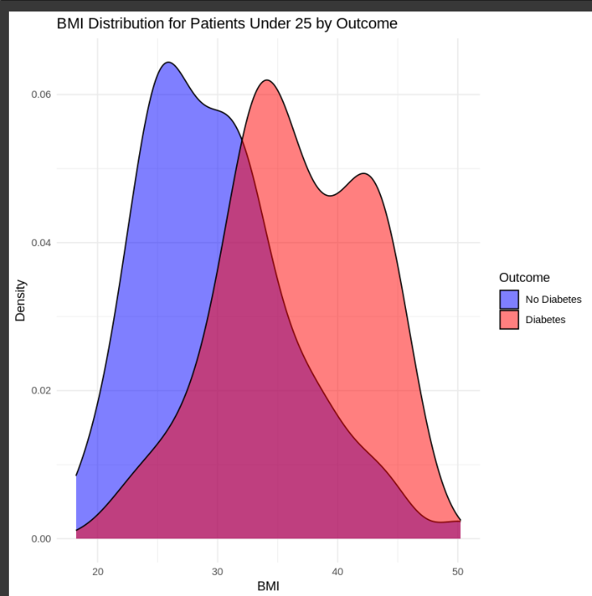
2 - Do young samples with high BMI more likely to be diagnosed as diabetic?
non diabetes Group : The BMI distribution peaks at around 25 (lower BMI values)
Diabetes Group : The BMI distribution peaks at around 34
conclusion: yes higher BMI is associated with a higher likelihood of diabetes for young people

Slide 23
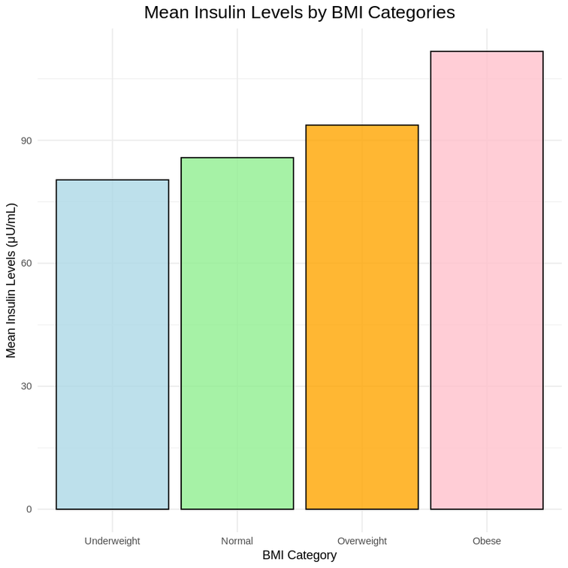
3. Do insulin levels vary by BMI categories?
yes, there is an direct relationship BMI categories and mean insulin levels as people in higher BMI categories has higher mean insulin levels compared to those in lower BMI categories

Slide 24
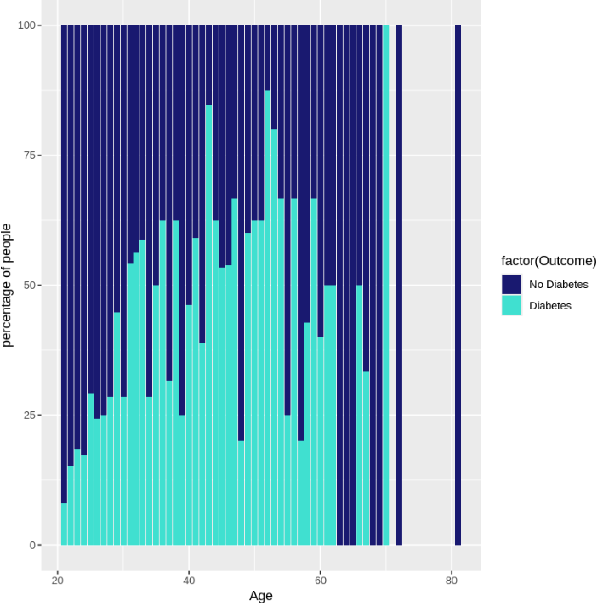
4 Does age affect diabetes?
yes , age is an important factor that affect diabetes as older group seems to have higher percentage of diabetes than the younger group

Slide 25
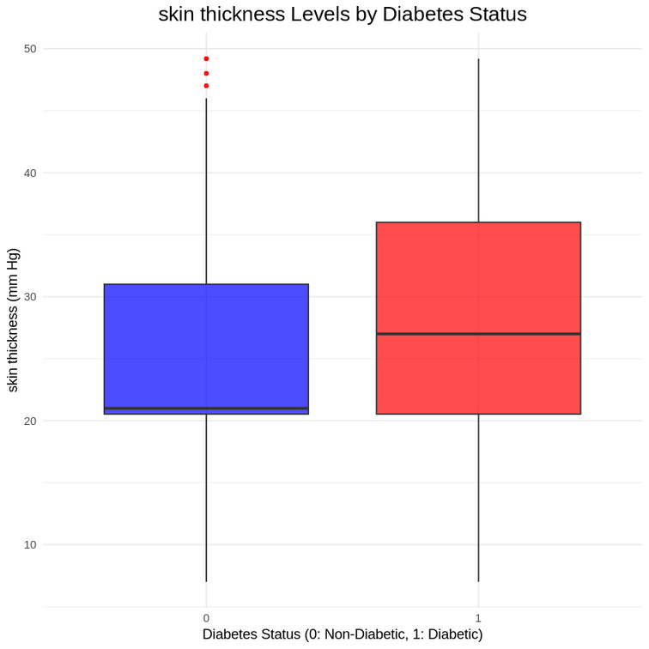
5.Does skin thickness affect diabetes?
yes high skin thickness is more likely related with diabetes

Slide 26
PART 3:
HYPOTHESIS TESTING

Slide 27
3.1 Claim: “There is a significant difference in glucose levels between diabetic and non-diabetic patients.”

Slide 28
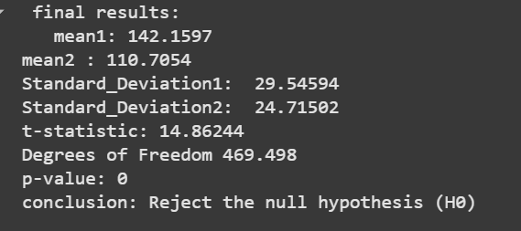
the hypotheses
conducted two samples T-test
P value is less than alpha So
Reject the null hypothesis (H0)
H0:μ1=μ2
Ha:μ1≠μ2

Slide 29
3.2 Claim: non-diabetic people have a higher insulin level than diabetic people.

Slide 30
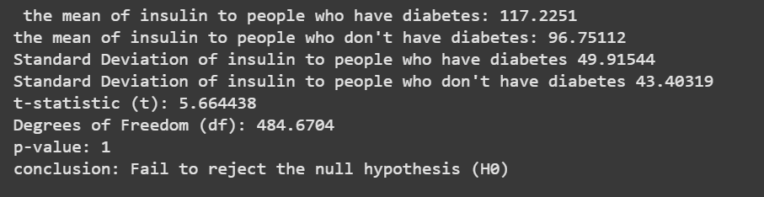
the hypotheses
conducted two samples T-test
P value is greater than alpha So,
fail to Reject the null hypothesis (H0)
H0:μ1≥μ2
Ha:μ1<μ2

Slide 31
PART 4: SIMULATION TASK

Slide 32
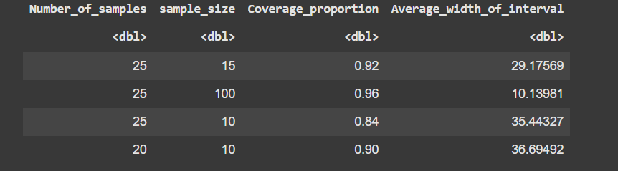
Confidence Interval Analysis
Sample Size: 15 (25 Samples)
Coverage Proportion: 0.92
Avg. Interval Width: 29.18
2.Sample Size: 100 (25 Samples)
Coverage Proportion: 0.96
Avg. Interval Width: 10.14
3.Sample Size: 10 (20 Samples)
Coverage Proportion: 0.90
Avg. Interval Width: 36.69
Insights:
Larger sample sizes result in narrower intervals and higher accuracy.
Smaller sample sizes show wider intervals and lower accuracy.

Slide 33
Thank you very much!

